Slide 1




Enhancing the User Experience with jQuery
Helping developers with greater capabilities, more flexibility, and user adoption
facebook.com/techman97
@andyboettcher
in/andyboettcher
andyboettcher.com

Slide 2

Introduction
Andrew Boettcher
  Senior CRM Advisor, Demand Chain Systems
    Salesforce Partner for 10 years, over 165 deployments
  Background
    Systems Engineer / Architect
    Software Development
    VoIP Telephony Integrations
  Virtual Stomping Grounds
    Twitter: @andyboettcher
    Blog: http://www.andyboettcher.com
    Force.com Discussion Boards: techman97

Slide 3
Agenda
Who are you?
What is jQuery / jQueryUI?
Why is it important to use technologies like jQuery?
How much is too much or too little?
Examples of jQuery / jQuery UI
Resources
Ping your Peers / Q & A

Slide 4
What is jQuery / jQueryUI?
jQuery (www.jQuery.com)
  Fast and Concise JS Library
    Simplifies HTML Document Traversing
    Event Handling
    Animations
    Ajax Interactions
jQueryUI (www.jQueryUI.com)
  Built on top of jQuery
    Low-level Interaction and Animation
    Advanced Effects
    Themeable Widgets

Slide 5
What REALLY is jQuery / jQueryUI?
A tool in your development arsenal
Help users see data easier
Help users work with data more effectively
Help management understand data better

Slide 6
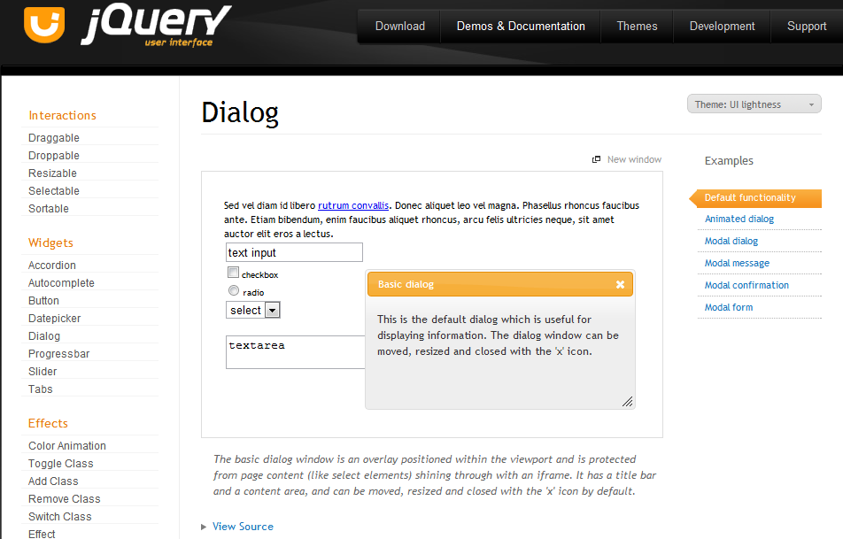
jQueryUI – test and try!

Slide 7
Why Important? Developers vs. Users
Developers use systems like developers
  Technically-minded
  Self-correcting
  Understanding of “glitches”
  Can switch paths mid-stream
Users use systems like users
  Process-minded
  Expectation of reliability and repeatability
  Frustrated easily with “glitches”
  Users single-handedly hold the key to ultimate “adoption”

Slide 8
Too Much? Finding the “Goldilocks Zone”
Good guidelines while considering jQuery
  jQuery components are never a focus, they compliment
    Salesforce is very powerful; leverage your platform
    Augment, augment, augment
    Replace only as a last resort
  jQuery is open-source
    Search far and wide for plug-ins
  Ask your users and leverage the Community!
    Be proactive, not reactive!
    #askForce / Force.com Discussion Boards
    StackExchange

Slide 9
How to Get Started with jQueryUI
Static Resource
  Create a ZIP file of assets
    Bundle Core, Widgets, and Plugins in one file
  Add to your Org
  Reference
External Resource (Google Code)
  Reference the external resource in VF
  https://developers.google.com/speed/libraries/devguide

Slide 10
Questions / Open Forum
What are your thoughts so far?
Want to see specific functionality?
Let’s hear from the audience: What have YOU done with jQuery / jQueryUI?

Slide 11
jQuery Example 1
Table Sorting and Inputs

Slide 12
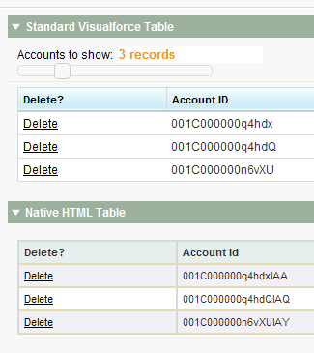

Slide 13
Example 1: Sorting and Inputs Recap
Extend Native Functionality
Augment with HTML and jQuery Functionality
Always Compliment; Never Overwhelm
  Be Subtle
  Think “Speed”
  Think “User”
  Think “Process”
Questions?
What do YOU think?

Slide 14
jQuery Example 2
Status and Modal Dialogs

Slide 15
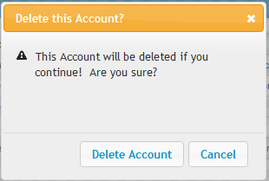
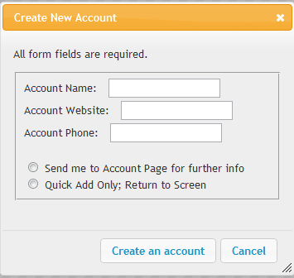
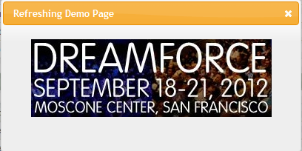


Slide 16
Example 2: Dialog Recap
Extend Native Functionality
Augment with HTML and jQuery Functionality
Always Compliment; Never Overwhelm
  Be Subtle
  Think “Speed”
  Think “User”
  Think “Process”
Questions?
What do YOU think?

Slide 17
jQuery Example 3
Drag and Drop / HTML5

Slide 18
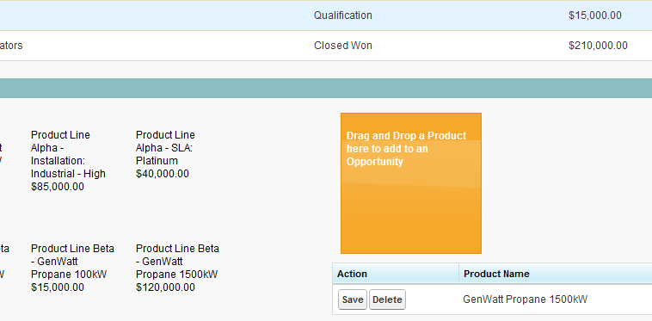

Slide 19
Example 3: Drag and Drop Recap
Extend Native Functionality
Augment with HTML and jQuery Functionality
Always Compliment; Never Overwhelm
  Be Subtle
  Think “Speed”
  Think “User”
  Think “Process”
Questions?
What do YOU think?

Slide 20
Recap
Why is it important to use technologies like jQuery?
How much is too much or too little?
You are the front line to User Adoption!
Resources: Never be afraid to ask for advice
  Twitter: #askForce and @andyboettcher
  Salesforce Developer Force Boards
  Reach out to Bloggers and Peers
Q & A

Slide 21
Thank you for your time!
Andrew Boettcher
  Senior CRM Advisor, Demand Chain Systems
    Salesforce Partner for 10 years, over 165 deployments
  Background
    Systems Engineer / Architect
    Software Development
    VoIP Telephony Integrations
  Virtual Stomping Grounds
    Twitter: @andyboettcher
    Blog: http://www.andyboettcher.com
    Force.com Discussion Boards: techman97

